Slide 1

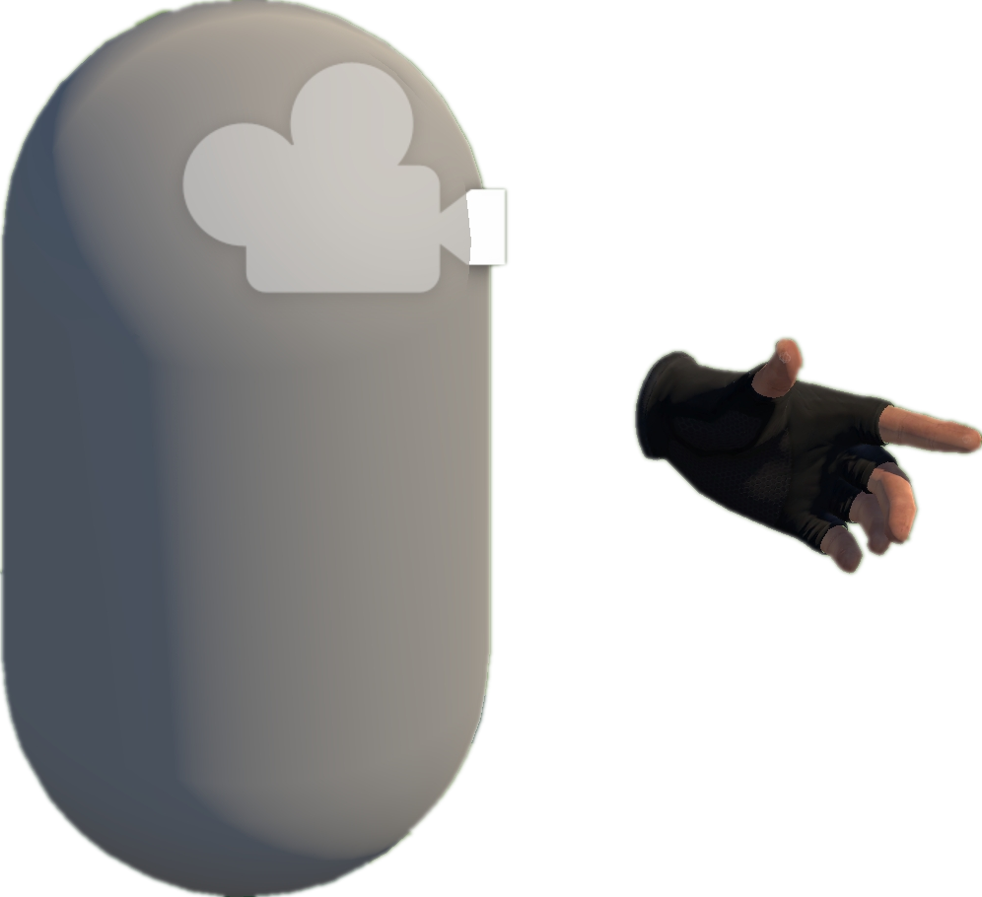










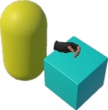
Project Collection
& Analysis (§3.1)
D
VRExplorer Test (§3.4)
A
3
Behavior Execution and Scene Exploration
Preliminary Scene Configuration
1
Camera
Collect By Tags & Topics
Hand Controller
Open Source
Repositories
Bake NavMesh
Unity-based
VR Projects
Original Scene
Scene with NavMesh (for navigation)
Collider
VRExplorer Agent
Hierarchy Analysis
Interaction & Scene Analysis
Implementation Interface
Code Analysis
All Scripts
2
Hierarchy
Customizing Entity Interface Configuration
PFSM
Autonomous Event Invocation
Environment
Core Logic Code & Third Plugin Analysis
Interactables
Task Execution
Box
Core Scripts
Decision Making
Scripts Implemented
Entity Interface
Task Execution
Autonomous
Event Invocation
extract the
abstraction model
Input Next
Interactable’s Mono
Model Abstraction (§3.2)
Output
Task
Model
B
EAT Framework (§3.3)
Task Generator
C
Abstraction of Interactable Objects
Task Generator & Customized Task Model
Example Task Model
Triggerable
Parallel and serial combinations
Grab-And-Drag-Box Task
Button, Joystick
Triggerable & Grabbable
Move to Approcach
Parallel Action
Gun, Cigarette Lighter
Base Action
Move Action
Grab Action
Inherit
Grab
Grabbable
Box, Coin
Grab Action
Trigger Action
Move Action
Walk Around
Asynchronous Action
Abstraction of Actions
Grab
Base Entity
Trigger
Press
Pressing
Trigger Action
+ Triggering Time
+ Triggering() + Triggered()
Inherit
Pressed
Grabbable Entity
Triggerable Entity
Pull
Pulling
Task Layer
Entity Interface
C# Scripts File
Relaxed
Action Layer
Fire
Pulling the trigger
Implement
Unity Scene
GameObjects
Triggered
Entity Layer
XR Box
XR Joystick
XR Button
Mono Scripts
Third Plugins
NavMesh Data
Notes:
单击此处添加文本

